Slide 1
CS2032 – Data Communications
Network Applications II
Storage, DNS, P2P
Gihan Dias
2020
Notes:
1
1

Slide 2
Outline
Storage (FTP, SFTP, SMB, NFS, WebDAV)
Domain Name System (DNS)
Peer to Peer Applications
2
Notes:
2
2

Slide 3
File Storage
Notes:
3

Slide 4
File Storage
Files are stored on a server in the network
Files are accessed by a client
May be integrated into the user interface (e.g. Windows Explorer) so user sees no difference to a local file
May be accessed from web browser or a client application
Notes:
4

Slide 5
File Transfer Protocol (FTP)
Original File Storage Protocol
defined in 1980
Used for transferring files to/from clients and servers
Uses TCP
FTP uses two connections
Control Connection – TCP on port 21
Data Connection – TCP on port 20
Provides authentication/access in the form of username and password
Notes:
5
5

Slide 6
Command Line ftp Session
$ ftp ftp.ripe.net
Connected to falcon.ripe.net.
220 This is the ftp-server of the RIPE Network Coordination Centre (NCC).
530 Please login with USER and PASS.
Name (ftp.ripe.net:gihan): ftp
331 Please specify the password.
Password:
230 Login successful.
Remote system type is UNIX.
Using binary mode to transfer files.
ftp> cd rfc
250 Directory successfully changed.
ftp> get rfc959.txt
local: rfc959.txt remote: rfc959.txt
227 Entering Passive Mode (193,0,19,26,150,183)
150 Opening BINARY mode data connection for rfc959.txt (147316 bytes).
226 File send OK.
147316 bytes received in 2.6 seconds (56 Kbytes/s)
ftp> quit
221 Goodbye.
Notes:
6

Slide 7
FTP
Some FTP commands
USER <username> - User identification
PASS <password> - Password for access
LIST – List the files in the current remote dir
RETR <filename> - Retrieve file
STOR <filename> - Upload a file to remote host
GET <filename> - Similar to RETR
PUT <filename> - Similar to STOR
Notes:
7
7

Slide 8
SFTP
Secure File Transfer Protocol
Transfers files over Transport Layer Security (TLS)
Similar to ftp
Has taken over ftp in many applications
Can use GUI interface
Notes:
8

Slide 9
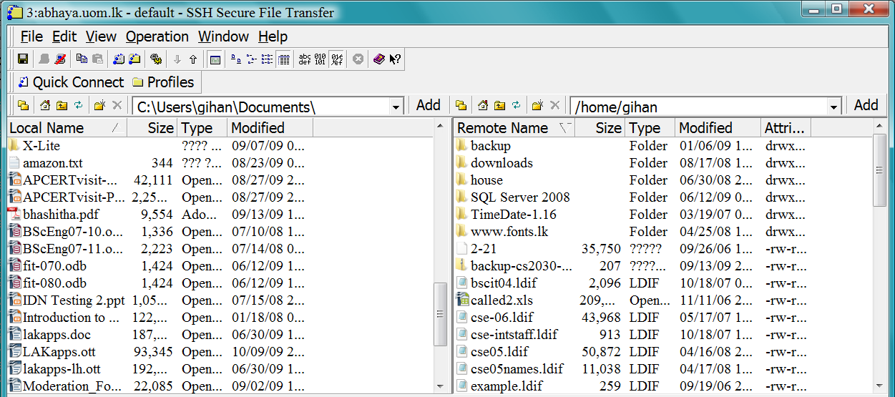
GUI File Transfer client
Notes:
9

Slide 10
Network File Systems
Also called Network Attached Storage (NAS)
Unix
Network File System (Sun)
Windows
SMB and CIFS
Allows users to access files stored on a server
Integrated into the GUI
Notes:
10

Slide 11
Network File Systems (cont.)
A set of files and folders is defined as a file system
A server can share one or more file systems
A client can mount a file system as a drive (e.g. h:) and then open, copy files etc.
File operations such as open, read, write, delete, etc. are sent from client to server
Notes:
11

Slide 12
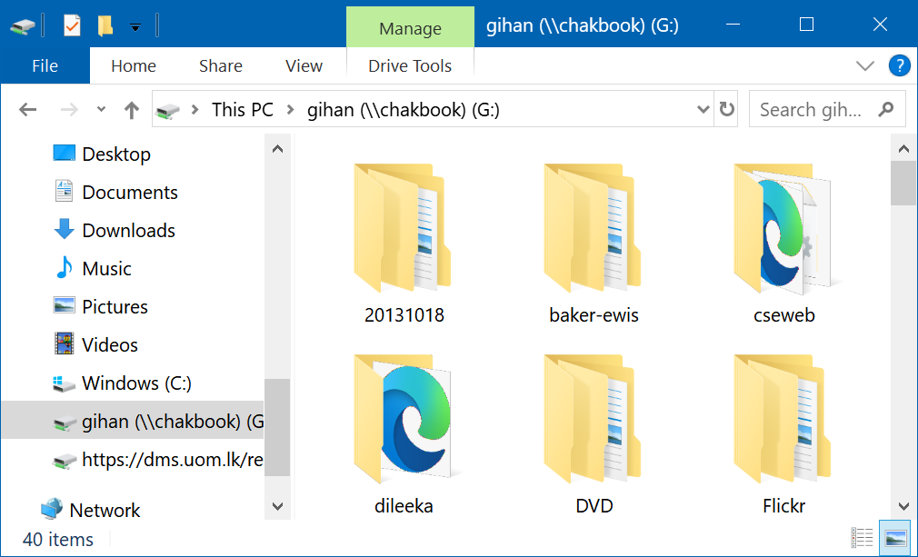
A Network Share on Windows

Slide 13
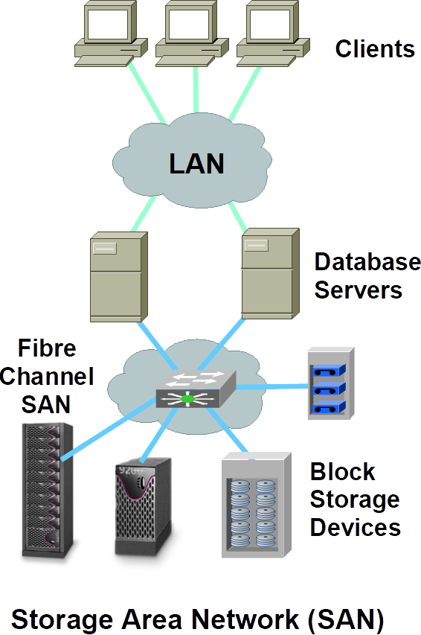
Storage-Area Networks
Specialised storage devices
Storage is accessed at block level
not at file level
High performance
Storage is shared among servers
Generally not clients
Management tools

Slide 14
Internet Storage
Storing files on the Internet
e.g. Dropbox, Google Drive
for storage space, backup and remote access
Issue: Internet is slower and less reliable than LAN
Web-based or client-based
WebDAV protocol
may also use SMB, etc.
Notes:
14

Slide 15
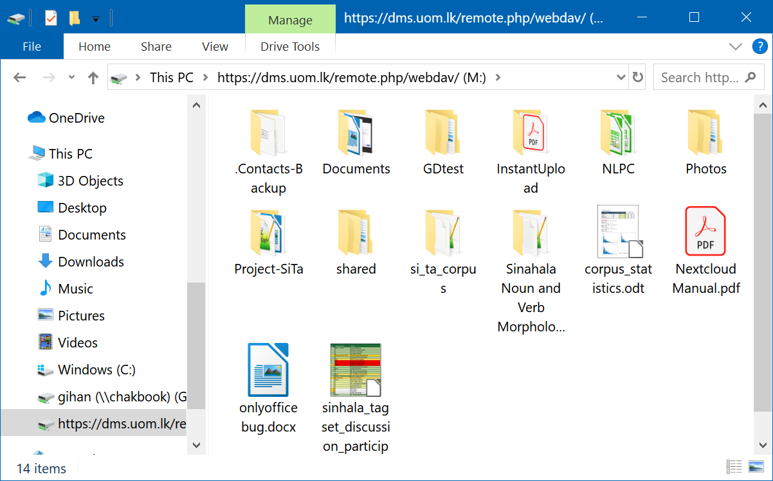
WebDAV filesystem on Windows

Slide 16
Domain Name Service (DNS)
Notes:
16

Slide 17
Introduction
Hosts in the Internet are identified by IP addresses
E.g. 192.248.8.100
Numeric addresses are not human friendly
Thus, alphanumeric hostnames are used
A scheme to map hostnames to their IP addresses is required
Initially a file (/etc/hosts) was used for this purpose
However, as the network grew it was difficult to update the hosts file in every host
Notes:
17
17

Slide 18
Introduction
The Domain Name System (DNS) was designed to overcome this problem
Defined in RFCs 1034 and 1035
Runs on port 53
DNS is a hierarchical, domain-based naming scheme
A distributed database system
Notes:
18
18

Slide 19
Introduction
Root DNS Servers
com DNS servers
org DNS servers
lk DNS servers
yahoo.com
DNS servers
pbs.org
DNS servers
uom.lk
DNS servers
slt.lk
DNS servers
amazon.com
DNS servers
Notes:
19
19

Slide 20
DNS Functions
The DNS translates between
Names and IP addresses
abc.lk => 123.56.88.126
Names and other information
foolish.lk => the society of foolish people
IP addresses and names
202.33.192.85 => host85.mycomp.org
Notes:
20
20

Slide 21
Servers & Clients
Name Servers
Store and manage information about domains
Respond to resolution requests for clients
Resolvers (clients)
Standard Name Resolution
Reverse Name Resolution
Electronic Mail Resolution
Notes:
21
21

Slide 22
Name Servers
Authoritative DNS servers
Organization’s DNS servers, providing authoritative hostname to IP mappings for organization’s servers (e.g., Web and mail).
Can be maintained by organization or service provider
Notes:
22
22

Slide 23
Name Servers
Local Name Server
Each ISP (residential ISP, company, university) has one.
Also called “default name server”
can use Google as a “local” name server
When a host makes a DNS query, query is sent to its local DNS server
Acts as a proxy, forwards query into hierarchy.
Reduces lookup latency for commonly searched hostnames
Notes:
23
23

Slide 24
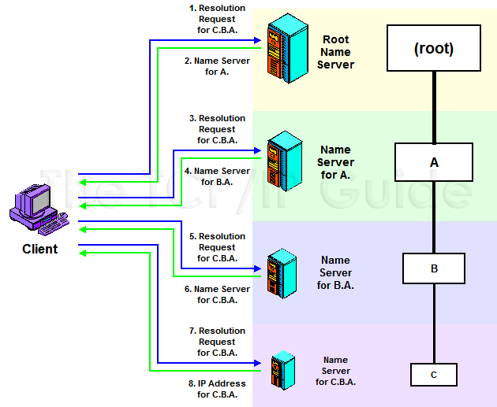
DNS Name Resolution - Iterative
Notes:
24
24

Slide 25
Peer-to-Peer (P2P) Applications
Notes:
25

Slide 26
Peer to Peer (P2P) Applications
A diversion from the client-server model
no specified client or a server
However, for a given transaction there is a client and a server
All peers have equal status
Applications
File Sharing
Instant Messaging
Online Gaming
Distributed Services
Notes:
26
26

Slide 27
P2P File Sharing
Example
Alice runs P2P client application on her notebook computer
Intermittently connects to Internet; gets new IP address for each connection
Asks for “Hey Jude”
Application displays other peers that have copy of Hey Jude.
Notes:
27
27

Slide 28
P2P File Sharing
Alice chooses one of the peers, Bob.
File is copied from Bob’s PC to Alice’s notebook: HTTP
While Alice downloads, other users uploading from Alice.
Alice’s peer is both a Web client and a transient Web server.
All peers are servers = highly scalable!
Notes:
28
28

Slide 29


P2P: Centralized Directory
Original “Napster” design
1) When peer connects, it informs central server:
IP address
content
2) Alice queries for “Hey Jude”
3) Alice requests file from Bob
Bob
centralized
directory server
1
peers
1
1
3
2
1
Alice
Notes:
29
29

Slide 30
P2P: Problems with Centralized Directory
Single point of failure
Performance bottleneck
Copyright infringement
File transfer is decentralized, but locating content is highly centralized
Notes:
30
30

Slide 31
Decentralised file Sharing
e.g. BitTorrent
No central directory
Each file (or group of files) has a set of controller nodes which contain info about the nodes storing / sharing the file
May use web or other mechanism to keep track of controllers

Slide 32
The BitTorrent Protocol

Slide 33
What is BitTorrent?
An efficient content distribution system using file swarming.
Usually does not perform all the functions of a typical p2p system, like searching.

Slide 34
File sharing in BitTorrent
File sharing
To share a file or group of files, a peer first
creates a .torrent file, a small file that contains
metadata about the files to be shared, and
Information about the tracker, the computer
that coordinates the file distribution.
Peers first obtain a .torrent file, and then connect
to the specified tracker, which tells them from which
other peers to download the pieces of the file.

Slide 35

BT Components
On a public site, obtain .torrent file. for example:
http://bt.LOR.net
http://bt.HarryPotter.com/
Web Server
The Lord of Ring.torrent
Harry Potter.torrent
Transformer.torrent
Notes:
35

Slide 36
File sharing
File sharing
Large files are broken into pieces of size between
64 KB and 1 MB
1
2
3
4
5
6
7
8

Slide 37





BT: publishing a file
Harry Potter.torrent
Bob
Web Server
Tracker
Downloader:
A
Seeder:
B
Downloader:
C
Notes:
37

Slide 38
The .torrent file
The URL of the tracker
Pieces <hash1, hash 2,…, hash n>
Piece length
Name of the file
Length of the file

Slide 39
The Tracker
IP address, port, peer id
State information (Completed or Downloading)
Returns a random list of peers

Slide 40
BitTorrent Lingo
Seeder = a peer that provides the complete file.
Initial seeder = a peer that provides the initial copy.
Leecher
Initial seeder
One who is downloading
(not a derogatory term)
Leecher
Seeder

Slide 41
Simple example
{1,2,3,4,5,6,7,8,9,10}
Seeder: A
{}
{1,2,3}
{1,2,3,5}
{}
{1,2,3}
{1,2,3,4}
{1,2,3,4,5}
Downloader C
Downloader B
Notes:
41

Slide 42
Basic Idea
Initial seeder chops file into many pieces.
Leecher first locates the .torrent file that directs it to a tracker, which tells which other peers are downloading that file. As a leecher downloads pieces of the file, replicas of the pieces are created. More downloads mean more replicas available
As soon as a leecher has a complete piece, it can potentially share it with other downloaders. Eventually each leecher becomes a seeder by obtaining all the pieces, and assembles the file. Verifies the checksum.

Slide 43
Summary
File Servers
Store files (documents, images) on the net
Domain Name Service
Converts from human-understandable names to machine understandable addresses
Peer-to-Peer
Data exchange without a central server
Services such as e-mail are also P2P
MTAs are both clients and servers

